Slide 1
Employee performance scorecard in excel
STUDENT NAME : S. Rithika
REGISTER NUMBER : 312209132
NM ID : 5CC6B209D4C6F148EB4489C298D35985
DEPARTMENT : B.COM ( Accounting &Finance)
COLLEGE : Anna Adarsh College For Women

Slide 2
PROJECT TITLE
CREATING AN EMPLOYEE PERFORMANCE SCORECARD
IN EXCEL

Slide 3
AGENDA
1. Problem Statement
2. Project Overview
3. End Users
4. Our Solution and Proposition
5. Dataset Description
6. Modelling Approach
7. Results and Discussion
8. Conclusion

Slide 4
Problem statement :
With a growing workforce, manually tracking employee performance becomes increasingly complex and prone to errors. The absence of a standardized performance scorecard leads to inconsistencies in evaluations, making it difficult to ensure fairness and transparency.
Develop an Excel-based employee performance scorecard tht standardizes the evaluation process, providing clear and consistent performance metrics for employees.
By implementing this performance scorecard, the organization will benefit from a streamlined and transparent performance evaluation process.

Slide 5
PROJECT VIEW :
Employee Performance Evaluation is a critical component of organizational success, directly influencing workforce productivity, employee morale and overall business outcomes. In today’s competitive environment ,it is essential for organizations to implement robust systems that accurately assess and monitor individual performance.
The performance scorecard integrates key features to highlight performance such as conditional formatting , to highlight performance levels, pivot table for data summarization and pie chart to visualize employees distribution.

Slide 6
WHO ARE THE END USERS?
The end users of the employee performance scorecard are:
Managers and supervisors:
They are the primary users responsible for evaluating employee performance . Managers use the scorecard to assess individual contributions, identify top performers etc.
2. Human Resources ( HR):
HR professionals use the scorecard to ensure consistency and fairness in the performance evaluation process across the organization.
3. Employees :
employees themselves can be secondary end users of the scorecard when they are given access to their own performance data.

Slide 7
4. Executives and senior leadership :
While not directly involved in day –to- day use, executives and senior leaders may review summarized performance data from the scorecard to inform strategic decisions, such as workforce planning, Talent management, and identifying leadership potential with in the organization.
5. Training and Development teams:
These teams may use the performance data to design
Targeted training programs that addresses specific gaps or enhance particular skills with in the workforce. The scorecard helps them to identify trends in employee performance that can inform their development strategies.

Slide 8
ONE SOLUTION AND ITS VALUE PROPOSITION:
The methods implemented in Creating an Employee performance scoreboard excel are:
Conditional Formatting : highlighted the employee names and performance score. In this showing the highest score , medium and low score using bar .
pivot table : summarize and analysis of employee performance score
Pie chart : chart shows the distribution of overall performance scores across different departments.

Slide 9
DATASET DESCRIPTION:
Https://www.Kaggle.com/models form this link the data set as been taken.
Data Set Description :
Employee ID :A unique identifier for each employee (eg.3427)
Employee name : Full name of the employee
Job title: The role of the employee with in the employee works ( eg. Engineer)
Performance metrics : employee performance based of attendance, task completion, quality of work etc.
Overall performance score: A weighted average of all the performance metrics, giving a final score ( e.g., out of 5)

Slide 10
MODELLING :
Step 1: Set up data set
1. Open excel : start with a blank sheet excel workbook.
2. create headers: Employee id, employee name, division, performance score, gender.
Step 2: Enter data : enter the following details of the employee data under corresponding header.
Step 3: enter the performance score
Step 4: apply conditional formatting in this choose data bars. Select the style to visually represent performance within each metric.
step 5: Go to the insert tab and choose pie chart, format the chart by adding a title and label each slice with department names and percentages.

Slide 11
Step 5: go to the insert tab and select pivot table. Choose where to place the pivot table , drag each header and select all rows and columns.
Step 6: This step –by-step process allows you to build a comprehensive employee performance scorecard in excel that is both visually engaging and analytical robust.

Slide 12
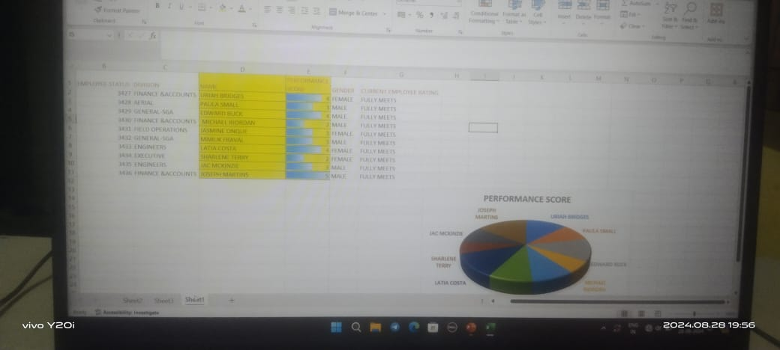
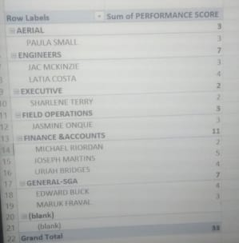
RESULT:
CONDITIONAL FORMATTING & PIE CHART
PIVOT TABLE

Slide 13
CONCLUSION:
.
Creating an employee performance scorecard in Xcel offers a powerful and accessible way to evaluate and manage employee performance. By integrating conditional formatting , pir e chart and pivot tables, you can transform raw performance data into clear, actionable insights.
Overall, this approach not only enhances the effectiveness of performance reviews but also promotes data – driven decision – making.

